Slide 1
Emergency Badge
2nd Charleville Lone Girl Guides

Slide 2
Our Girl Guide Promise
I promise that I will do my best
To be true to myself and develop my beliefs
To serve my community and Australia
And live by the Guide Law

Slide 3
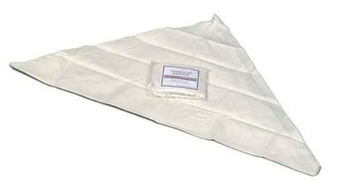
What is a triangular bandage?
Notes:
Demonstrate and discuss

Slide 4
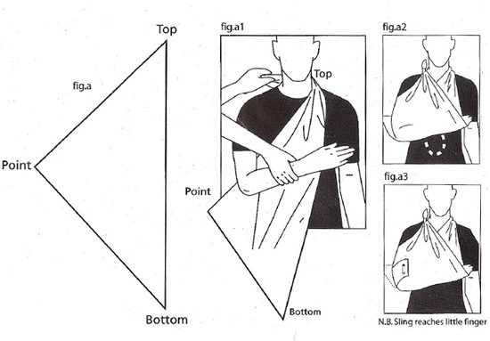
Let’s Make a Sling
Notes:
Demonstrate and discuss

Slide 5
Why would someone need a sling?
Notes:
Use the annotation tool to have girls write on the screen or just discuss

Slide 6
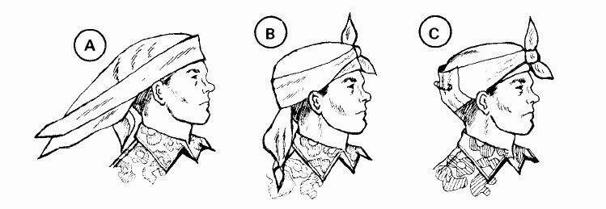
Stop bleeding from the head
Notes:
Demonstrate and discuss

Slide 7
Reflection: what was the most fun today?

